Slide 1
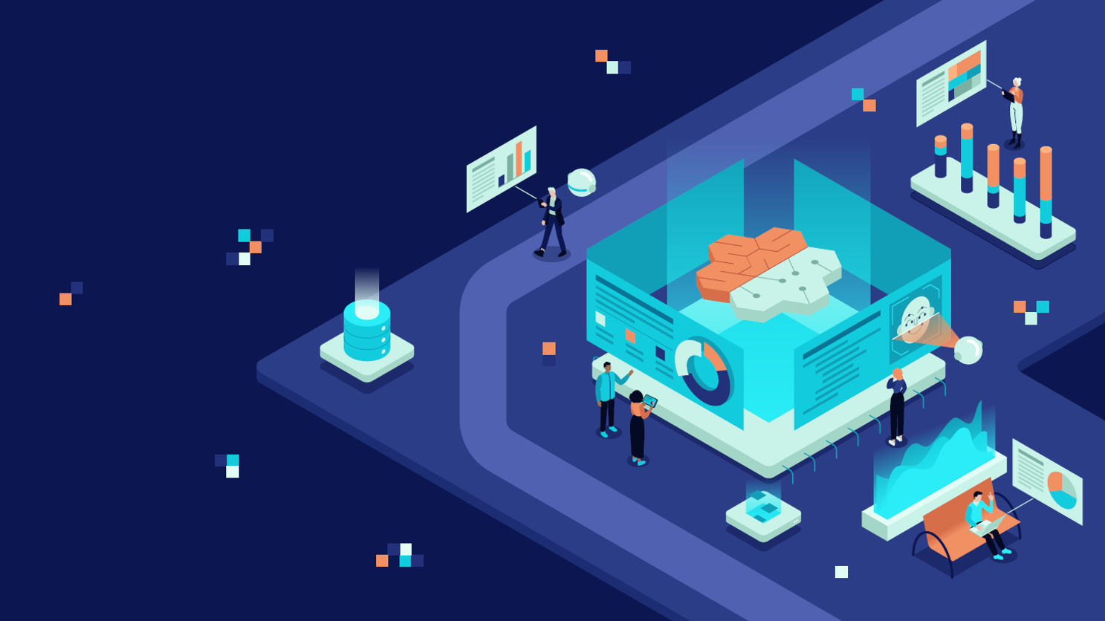
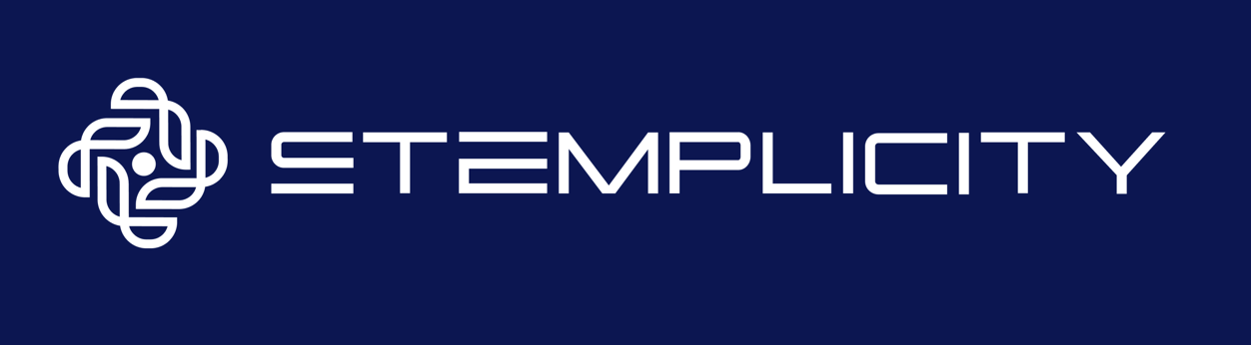
BUILD INTERACTIVE MULTIMODEL AI AGENT TEAMS WITH AUTOGEN

Slide 2



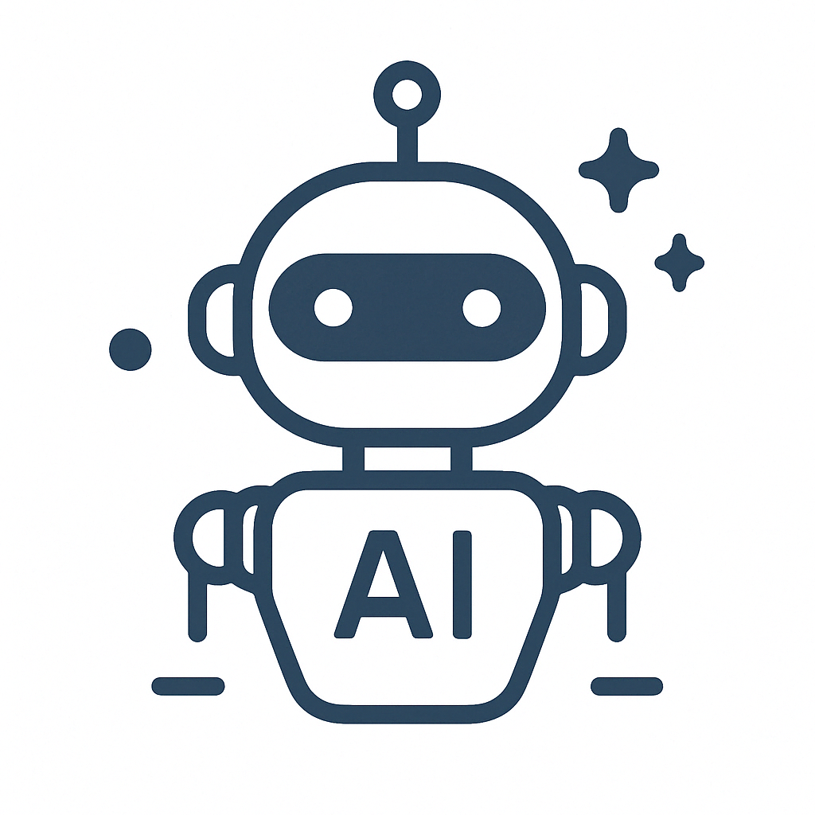
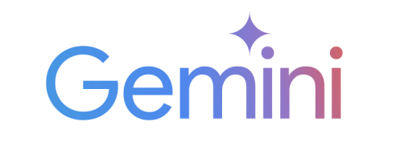
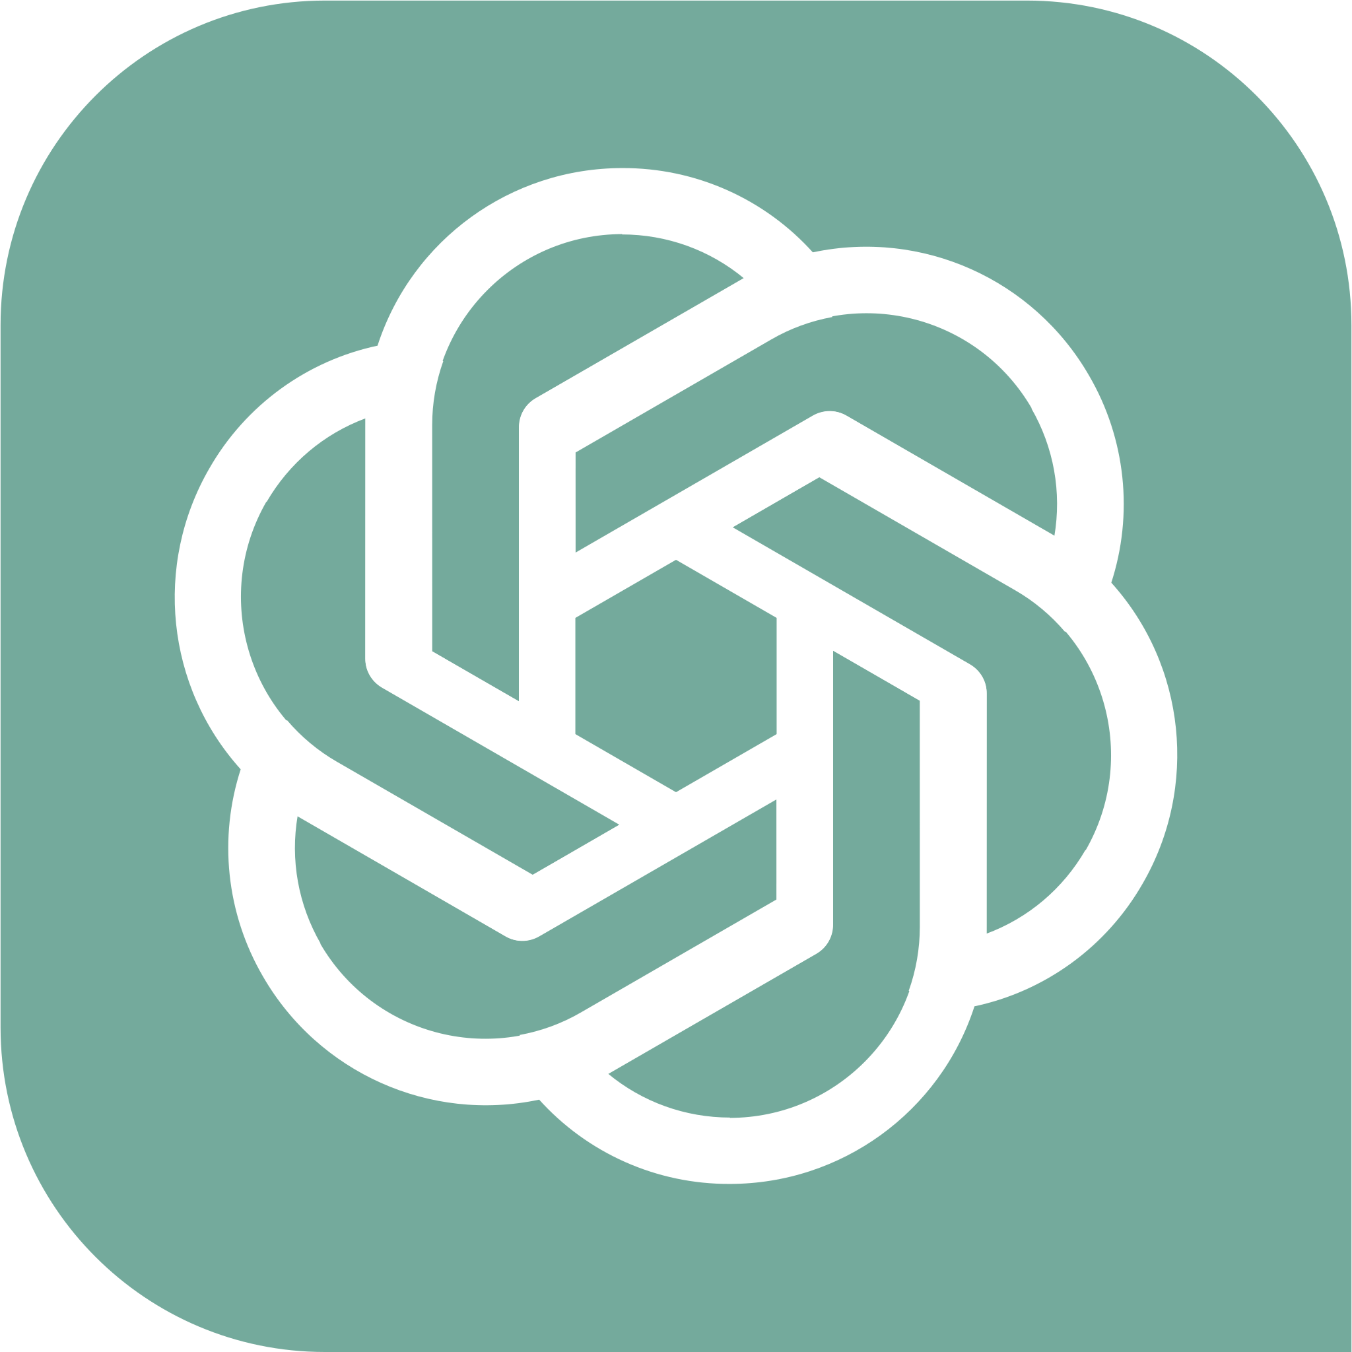
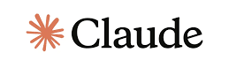

Project overview
Group Chat Manager
Chief Marketing Officer (CMO)
GroupChatManager( )
autogen.ConversableAgent( )
Marketing Manager
Social Media Strategist
autogen.ConversableAgent( )
autogen.ConversableAgent( )
Brainstorming a Marketing Campaign
© All rights reserved for Dr. Ryan Ahmed @Stemplicity Inc.
Human
autogen.UserProxyAgent( )

Slide 3
What is AutoGen?
AutoGen is an open-source framework that simplifies how we build and manage multi-agent systems using Large Language Models like GPT-4.1, Claude, etc.
It helps you orchestrate multiple AI agents that can automatically talk to each other, collaborate, and solve complex tasks.
© All rights reserved for Dr. Ryan Ahmed @Stemplicity Inc.

Slide 4
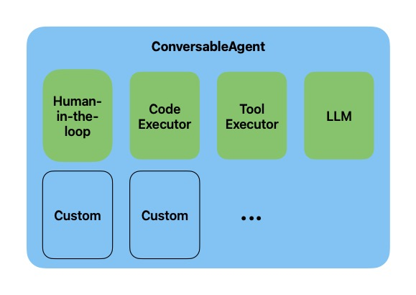
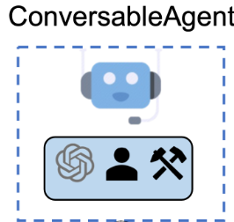
What is an Agent in AutoGen?
In AutoGen, an agent is an entity that can send and receive messages to and from other agents in its environment.
An agent can be powered by LLMs models, code executors (such as an IPython kernel), human, or a combination of these and other pluggable and customizable components.
© All rights reserved for Dr. Ryan Ahmed @Stemplicity Inc.
Documentation link: https://microsoft.github.io/autogen/0.2/docs/tutorial/conversation-patterns

Slide 5
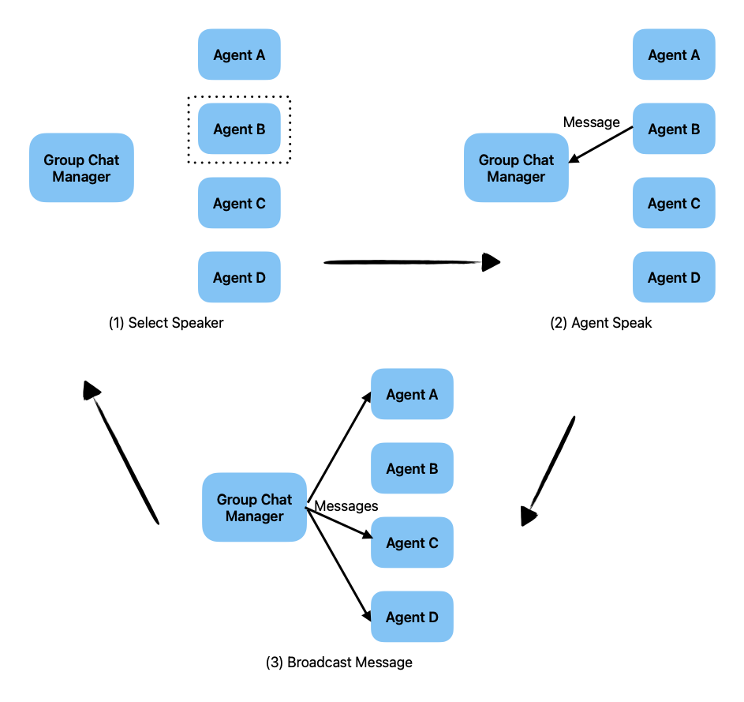
Group Chat
AutoGen provides a conversation pattern called “group chat”, which involves more than two agents.
The idea of group chat is that all agents contribute to a single conversation thread and share the same context. This is useful for tasks that require collaboration among multiple agents.
A group chat is orchestrated by a special agent type “GroupChatManager”. At first, the Group Chat Manager selects an agent to speak. Then, the selected agent speaks, and the message is sent back to the Group Chat Manager, who broadcasts the message to all other agents in the group. This process repeats until the conversation stops.
© All rights reserved for Dr. Ryan Ahmed @Stemplicity Inc.
Documentation link: https://microsoft.github.io/autogen/0.2/docs/tutorial/conversation-patterns

Slide 6

Key Learning Outcomes
Understand the basic concept of multi-model AI Agents in AutoGen.
Modify agents to use different multi-model LLMs (e.g., Gemini for CMO, GPT for Marketer).
Configure AutoGen and load API keys for both OpenAI and Google Gemini.
Create single model AI Agents including a Marketing CMO and Brand Marketer using OpenAI's GPT first.
Make the AI agents discuss ideas using AutoGen's chat capabilities (initiate_chat, max_turns).
Introduce Human Oversight: Add a "User Proxy" agent with a human in the loop.
© All rights reserved for Dr. Ryan Ahmed @Stemplicity Inc.

Slide 7
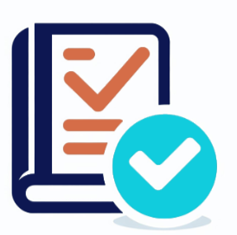
Summary
AutoGen is a powerful framework that enables developers to build multi-agent systems with just a few lines of code.
These agents can seamlessly collaborate using LLMs like OpenAI’s GPT, Anthropic’s Claude, and Google’s Gemini.
You can even configure human oversight to join and contribute within multi-agent conversations.
AI agents are shaping the future of work and there’s never been a more exciting time to be part of it!
© All rights reserved for Dr. Ryan Ahmed @Stemplicity Inc.

Slide 8
Thank you!

